Slide 1

Deep Learning
Lecture 8: Graph Neural Networks
Stan Z. Li

Slide 2
Outline
Introduction on Graphs
Deep Learning for Graphs
Graph Convolutional Networks
Applications by GNNs

Slide 3
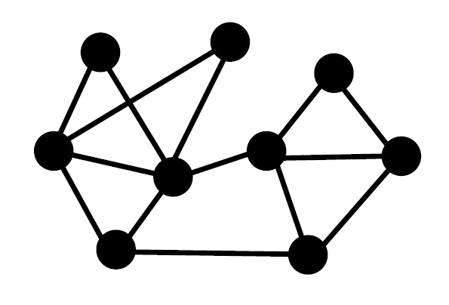
What’s Graphs?
Graphs are a general language for describing and analyzing entities with relations/interactions.

Slide 4
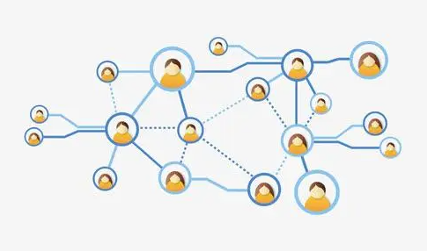
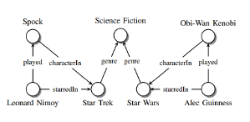
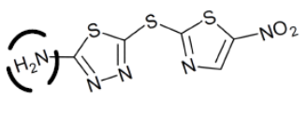
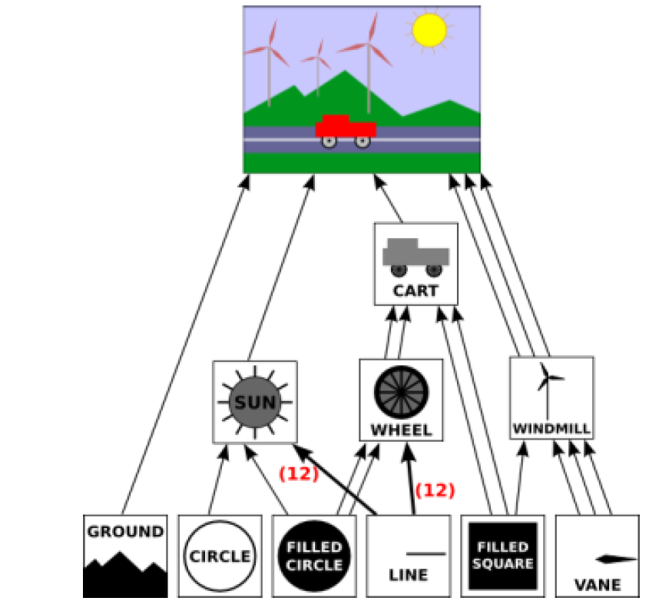
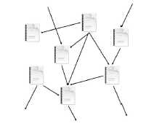

Graph-structured Data are Everywhere
Social Networks
Knowledge Graph
Molecule Graph
Sense Graph
Citation Graph
InterNet

Slide 5
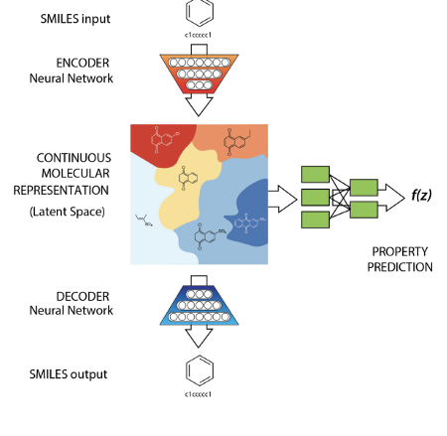
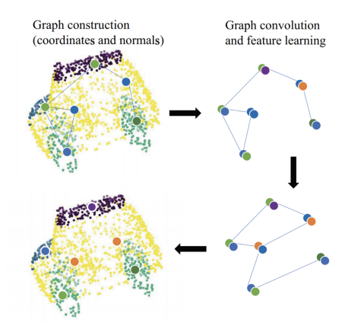
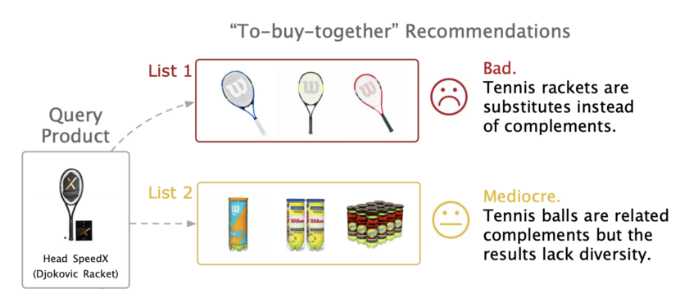
Graph-related Applications
Recent years have witnessed the great success of various graph algorithms in handling graph-related tasks.
Drug Discovery
Recommendation
Point Cloud Classification

Slide 6
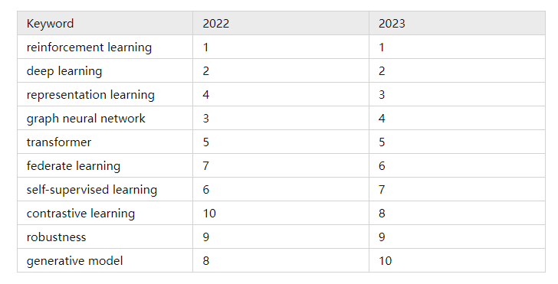
Keywords ICLR 2022 and 2023
Graph neural networks always occupy the top five.

Slide 7
Outline
Introduction to Graphs
Deep Learning for Graphs
Graph Convolutional Networks
Applications by GNNs

Slide 8
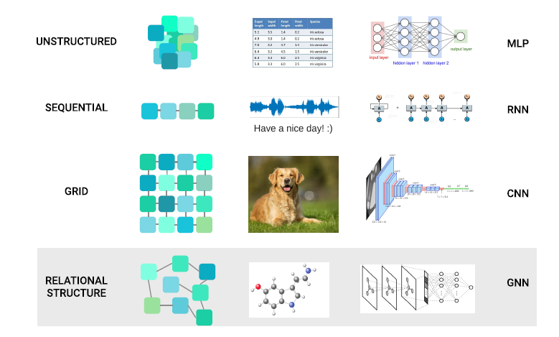
Choose Your Model
Choose your model for specific types of data.

Slide 9
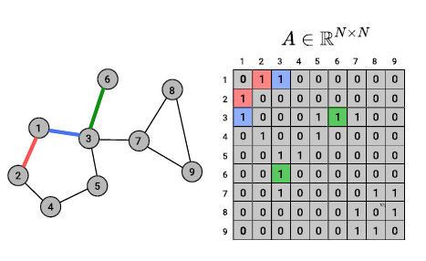
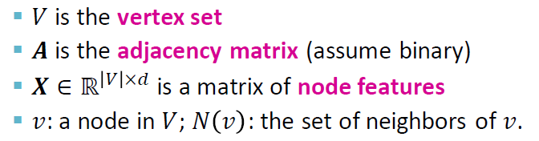
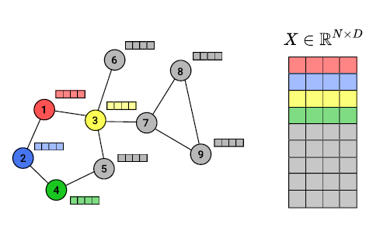
Graph Data
Assume we have a graph G
Main question: How do we take advantage of relational structure for better prediction?

Slide 10
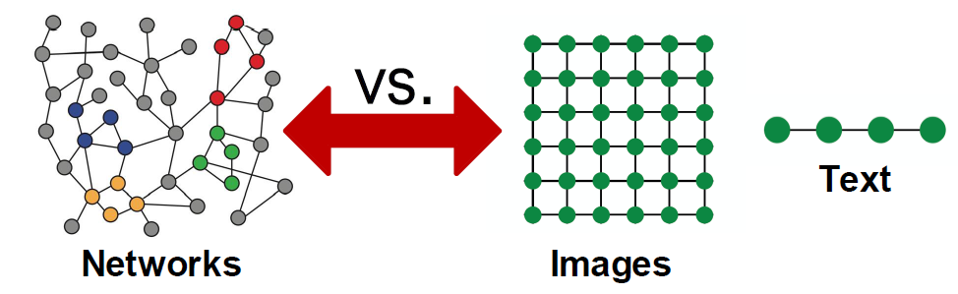
Why is Graph Deep Learning Hard?
Arbitrary size and complex topological structure
No fixed node ordering or reference point

Slide 11
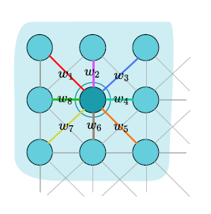
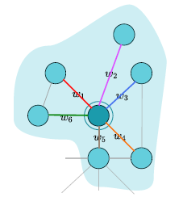
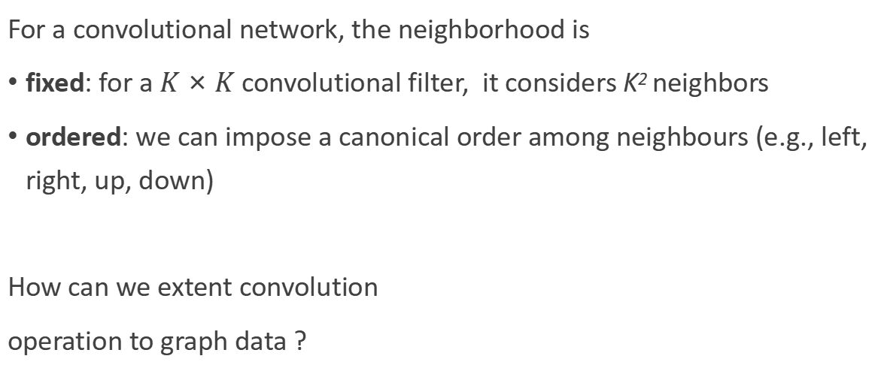
Convolutional Network
For a convolutional network, the neighborhood is
fixed: for a $K×K$ convolutional filter, it considers K² neighbors
ordered: we can impose a canonical order among neighbours (e.g., left, right, up, down)
How can we extent convolution
operation to graph data ?
?

Slide 12
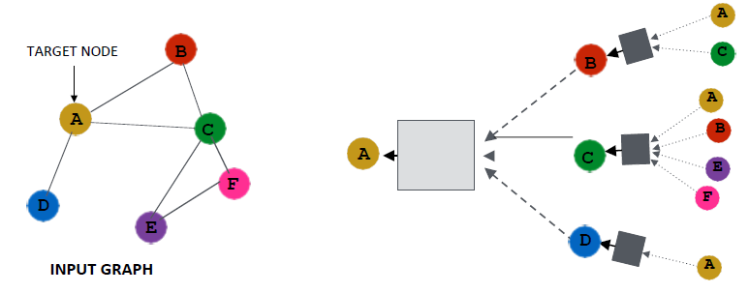
Convolutional Network on Graphs
Key idea: Generate node embeddings based on local neighborhoods.

Slide 13
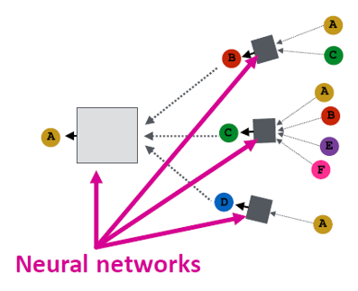
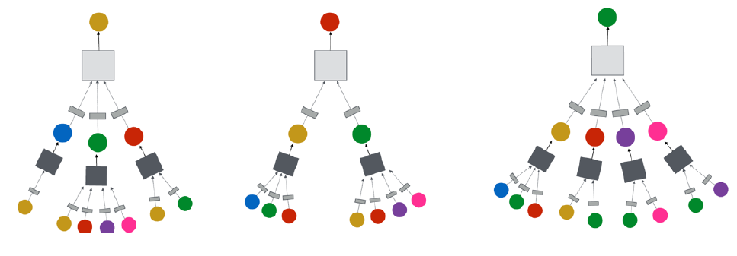
Convolutional Network on Graphs
Each node defines a computation graph based on its neighborhood.
Message Passing Mechanism: Nodes aggregate information from their neighbors using neural networks.

Slide 14
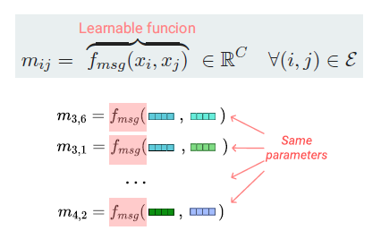
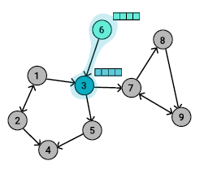
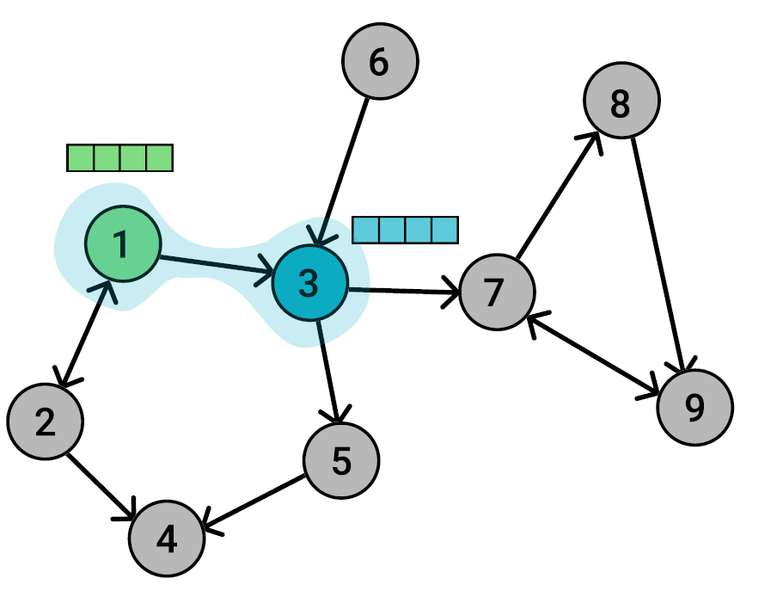

Message Passing - Send
For each pair of two connected nodes, create a message
$fmsg$ is a learnable function (e.g., an MLP)
its parameters are shared between each pair of nodes

Slide 15
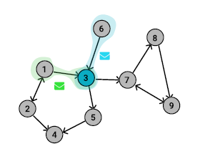
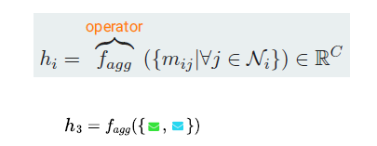
Message Passing - Aggregation
For each node, aggregate the messages from all its neighbors
usualy not learnable: eg. sum, mean, max, min
learnable: e.g., LSTM

Slide 16
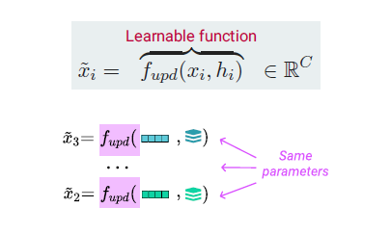
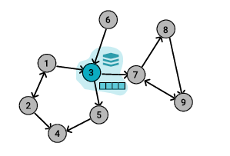
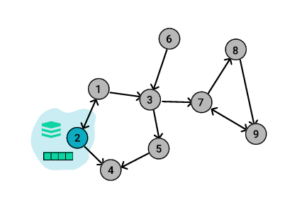

Message Passing - Update
For each node, update its representation using aggregated message
$fupd$ is a learnable updating function (e.g., an MLP)
its parameters are shared between all the nodes

Slide 17
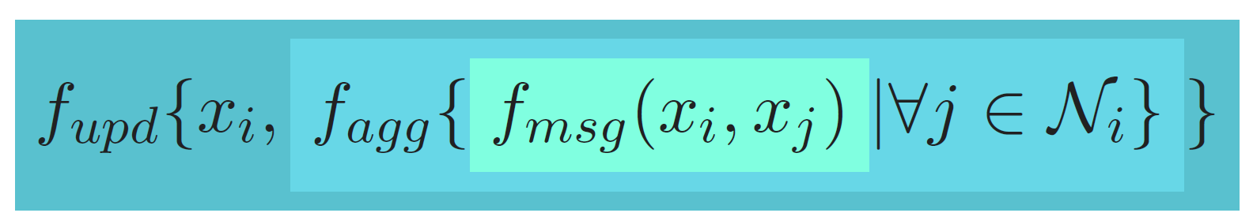
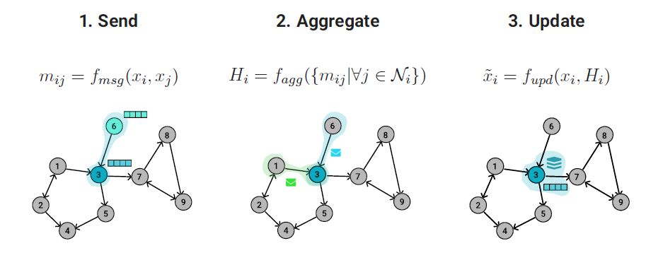
Message Passing - Overview

Slide 18
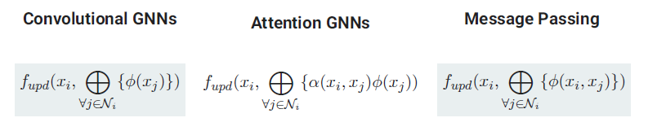
A General GNN Framework
Depending on how the three functions are instantiated, different GNN architectures could be obtained:

Slide 19
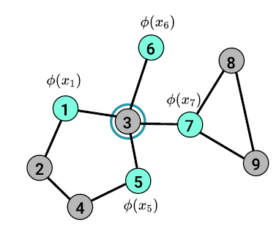
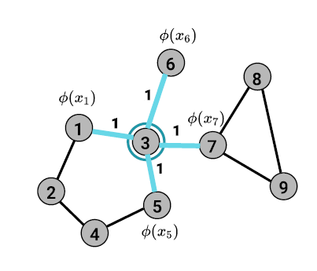
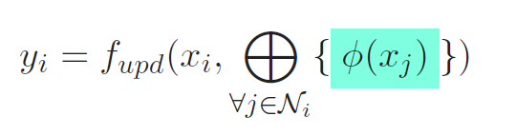
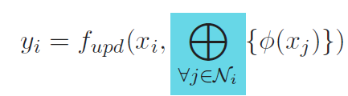
Graph Convolutional Networks
Messages depend only on the source nodes
Aggregation function is implemented as a sum/mean operation
Kipf and Max Welling. Semi-supervised classification with graph convolutional networks. ICLR, 2017.

Slide 20
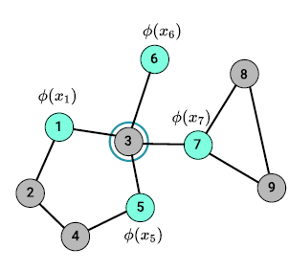
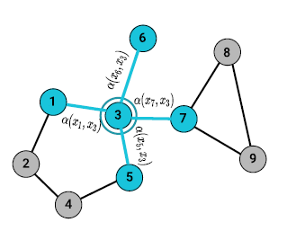
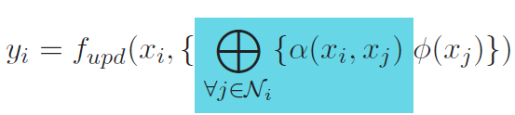
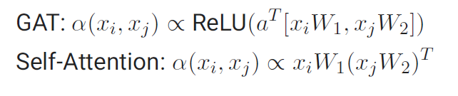
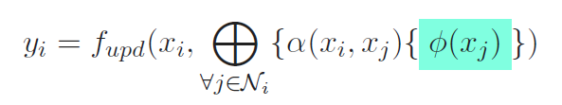
Graph Attention Networks
Messages depend only on the source nodes
Aggregation function is based on attention mechanism
Velickovic et. al Graph attention networks. ICLR, 2018.

Slide 21
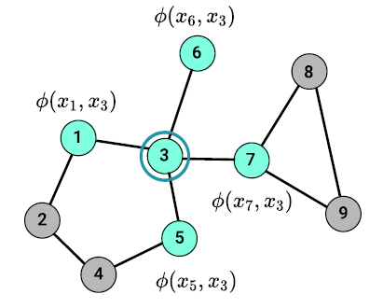
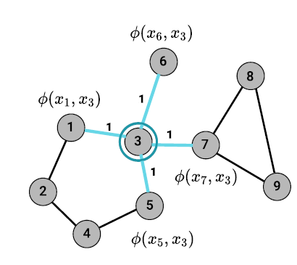
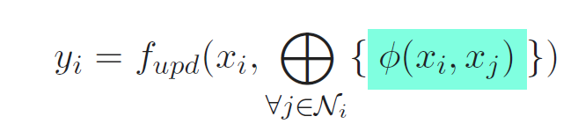
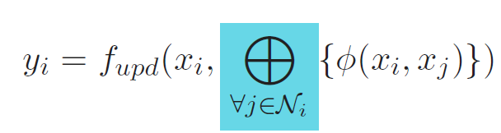
Message Passing Neural Networks
Messages depend on both source and destination; if edge features are available, the message could also take them into account
Aggregation function is implemented as a sum/mean operation
Gilmer et. al. Neural message passing for quantum chemistry. ICML, 2017.

Slide 22
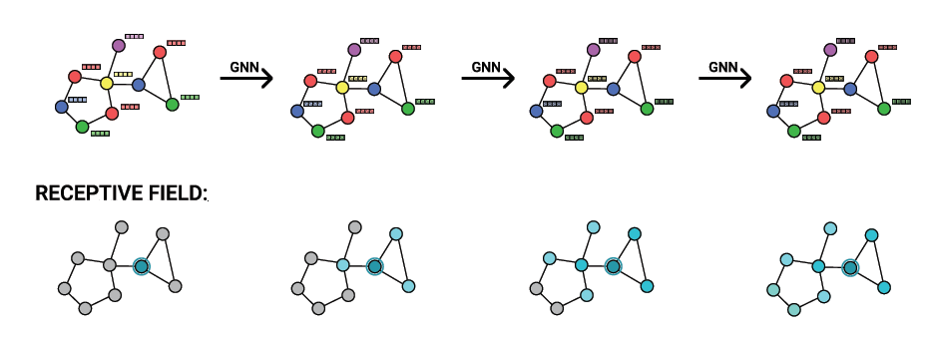
Multiple Layers
For a more powerful representation, we can stack multiple layers
Each layer increases the receptive field of each node

Slide 23
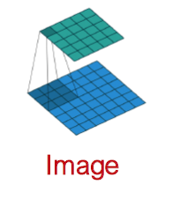
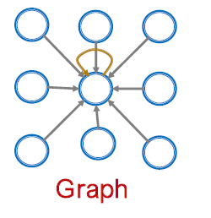
GNNs vs. CNNs
CNNs is a special GNNs with fixed neighbor size and ordering:
The size of the filter is pre-defined for a CNN.
The advantage of GNN is that it can process arbitrary graphs with different degrees for each node.
CNNs is not permutation invariant, switching the order of pixels will leads to different outputs.

Slide 24
Outline
Introduction on Graphs
Deep Learning for Graphs
Graph Convolutional Networks
Applications by GNNs

Slide 25

Graph Convolutional Networks (GCNs)
Average neighbor information and apply a neural network.

Slide 26



GCNs - Matrix Formulation
Many aggregations can be performed efficiently by matrix operations.
$A$ is an adjacent matrix, $Au,v$= 1 if node u and node v is connected, otherwise $Au,v$ = 0;
$D$ is a degree matrix, where $Dv,v$ = Deg($v$) = $|N(v)|$

Slide 27

GCNs - Matrix Formulation
Rewriting update function in matrix form:
Note: not all GNNs can be expressed in a matrix form, especially when aggregation function is complex.

Slide 28

How to Train GCN
Supervised setting: Directly train the model for a supervised task (e.g., node classification), e.g., using cross entropy loss.

Slide 29


How to Train GCN
Unsupervised setting: Use the graph structure as the supervision
“Similar” nodes have similar embeddings.
where $yu,v$ = 1 when node 𝑢and 𝑣are similar;
$CE(·,·)$ is the cross entropy;
$DEC(·,·)$ is the decoder such as inner product.

Slide 30
Outline
Introduction on Graphs
Deep Learning for Graphs
Graph Convolutional Networks
Applications by GNNs

Slide 31

Different Levels of Tasks
Four Levels: Node-level, Subgraph-level, Edge-level, and Graph-level

Slide 32

Node-level Tasks
Protein Folding: A protein sequence can be folded into 3D structure
Nodes: Amino acids (residues) in a protein sequence
Edges: Interaction between amino acids

Slide 33


Node-level Tasks
Traffic forecasting: Predict the trafficc flow in the next minutes
Nodes: Traffic stations
Edges: Proximity between distance or topology of the streets

Slide 34

Subgraph-level Tasks
Motif Discovey: Discover key functional groups in a molecular
Nodes: Atoms in a molecular graph
Edges: Valence bonding links between atoms

Slide 35

Subgraph-level Tasks
Graph Explainability: Identify key subgraphs behind the predictions
Nodes: Users in a sport-themed social network
Edges: Interlinking between users

Slide 36

Edge-level Tasks
Recommendation System: Find Recommend items users might like
Nodes: Users and items
Edges: User item interactions

Slide 37


Edge-level Tasks
Drug-Drug Interactions: Predict the interactions between two drugs
Nodes: Drugs & Proteins
Edges: : Interactions

Slide 38


Graph-level Tasks
Action recognition: Classify the action in the video
Nodes: objects / entities in the video
Edges: represent similarity or interactions between objects

Slide 39

Graph-level Tasks
Drug Design: Generate antibiotics (small molecular graphs)
Nodes: Atoms
Edges: Chemical bonds

Slide 40
Q & A

Slide 41
Reference
Course material covering similar topics from other institutions:
[Stanford CS 224W]: Machine Learning with Graphs
[University of Bucharest, 2021]: Introduction in Graph Nets
[AAAI2023 Tutorials]: Graph Neural Networks: Foundations, Frontiers, Applications

Slide 42
下 课

